Slide 1
Digestion Day 4
Large Intestine

Slide 2
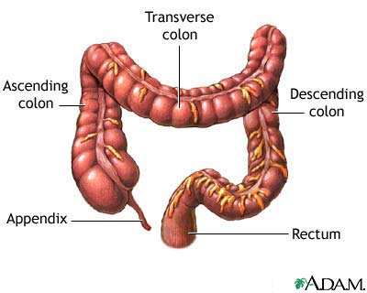
Large Intestine
Named based on diameter not length
1.5 meters long
Forms an upside down U in abdo. cavity
Absorbs water and electrolytes
Forms and stores feces

Slide 3
Parts of Large Intestine
Cecum
Dilated, pouchlike structure next to ileum of small intestine.
Contains narrow tube of lymphatic tissue called Appendix.
Colon
Four parts:
Ascending colon
Begins at cecum and continues upward on right side of body
Transverse colon
Top part of U, longest, most moveable
Descending colon
Follows downward on left side of body
Sigmoid colon
S-shaped curve prior to rectum

Slide 4
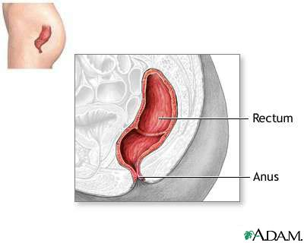
Parts of Large Intestine Cont.
Rectum
Lies next to saccrum, ends 5 cm below coccyx
Anal Canal
Last 2.5-4 cm of large intestine, contains mucus membrane, 6-8 longitudinal anal columns
Contains opening to the outside (Anus)
Two sphincters guard Anus
Internal anal sphincter muscle-involuntary control
External anal sphincter muscle-voluntary control

Slide 5
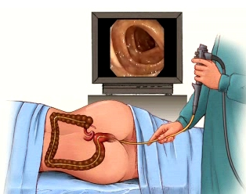
Structure of Large Intestinal Wall
Similar to other parts of alimentary canal but lacks villi
Contains pouches (haustra) made up of longitudinal muscle fibers
Colonoscopy:
People over 50 years of age or with a family history of colorectal cancer should have a screening of the large intestine, performed with a fiber optic colonoscope. Under sedation, this flexible lit tube is inserted into the rectum, and polyps and tumors are identified and removed. Computed tomographic colongraphy requires the same prepartory bowel clensing but does not require dedation and is not invasive and is faster and less costly. However, if a lesion is detected, fiberoptic colonoscopy must be used to remove the suspicious tissue.

Slide 6
Function of the Large Intestine
Little or no digestive function in contrast to small intestine
Secretes mucus from mucous glands
Protects intestinal wall against abrasive action
Binds particles of fecal matter
Alkalinity helps control pH of contents
Chyme in lg. intestine is all things not digested or absorbed by sm. intestine
Also contains water, electrolytes, mucus and bacteria

Slide 7
Functions Cont.
Absorbs water and electrolytes in proximal half of tube.
Remaining feces is stored in distal end until it is expelled
Bacteria
Intestinal flora
Breaks down some molecules that excape actions of digestive enzymes
Helps break down cellulose and vitamins K, B12, Thiamine, and Riboflavin
Can cause intestinal gas (flatus)

Slide 8
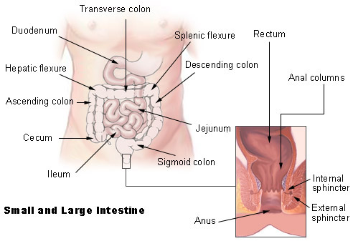
Movements of Large Intestine
Mixing and Peristalsis
Slower than small intestine
Peristaltic waves happen only 2-3 times per day
Colitis-frequent mass movements caused by inflamed portion of colon
Defecation Reflex
Initiated by person holding
a deep breath and
contracting abdominal
wall muscles
An increase in abdominal
cavity pressure is needed for
fecal matter to be forced out
of rectum

Slide 9
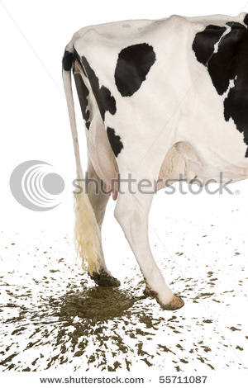
FECES!
Materials not digested or absorbed, plus water electrolytes mucus, shed intestinal cells and bacteria.
75 % water
Color is derived from bile pigments altered by bacterial action
Odor results from a variety of compounds that bacteria produce

